Slide 1
CS2030 LAB 6
B12A

Slide 2
Admin
01
Streams
02
AGENDA
Start coding!
03

Slide 3
Attendance

Slide 4
01
Admin

Slide 5
Admin
New levels have been released for the DES project, do check it out!
The project will have been regraded to accommodate for the new levels

Slide 6
PriorityQueue
For the project, you will probably need to make use of PriorityQueue
PriorityQueue basically does NOT sort the entire list; only guarantees that the first element (head of the queue) will be the least
If comparator is not defined, will use natural ordering
FYI: Underlying data structure is a min/max heap (covered in CS2040)
Demo
Remember to implement your own Comparator<T> for your own defined classes!

Slide 7
Streams
Introduction
Source operations
Intermediate operations
Terminal operations

Slide 8
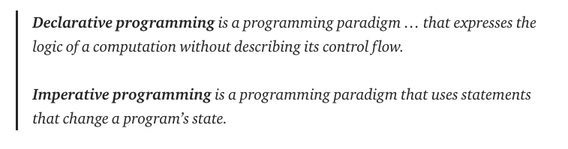
Streams - Introduction
Streams are a form of declarative programming
(taken from https://codeburst.io/declarative-vs-imperative-programming-a8a7c93d9ad2)

Slide 9
Streams - Introduction
Imperative programming:
for (int i = 0; i < n; i++) {
System.out.println(i);
}
Declarative programming:
IntStream.range(0, n)
.forEach(System.out::println);

Slide 10
Streams - Main types of operations
Source operations - generate data (LAZY)
Intermediate operations - manipulate data (LAZY)
Terminal operations - get actual data (EAGER)
Streams make heavy use of lambda expressions, so get used to writing the syntax
Functional interfaces

Slide 11
Streams - Source operations
IntStream
Stream
Stream from Arrays/Collections

Slide 12
Streams - Source operations
IntStream:
Generate elements from m to n - 1
static IntStream range(int m, int n);
Generate elements from m to n
static IntStream rangeClosed(int m, int n);

Slide 13
Streams - Source operations
Stream:
Creates a stream with the values in it
static Stream<T> of(T... values)
Creates a stream with one element in it, t.
static Stream<T> of(T t)

Slide 14
Streams - Source operations
Arrays/Collections
Arrays:
Arrays.stream(arr)
Collections:
Arrays.asList(arr).stream()
new ArrayList<>(...).stream()

Slide 15
Streams - Intermediate operations
Maps all the elements in the streams given the function in the argument
<R> Stream<R> map(Function<? super T,? extends R> func);
For example:
IntStream.range(1, 3).map(x -> x + 1);
// Returns a stream of 2 and 3

Slide 16
Streams - Intermediate operations
We can have nested streams & flatten them
Maps and flattens the elements in the streams given the function in the argument
<R> Stream<R> flatMap(Function<? super T,? extends Stream<? extends R>> mapper)
For example:
IntStream.range(1, 3).flatMap(x -> IntStream.range(1, 3))
// Returns a stream of 1, 2, 1, 2

Slide 17
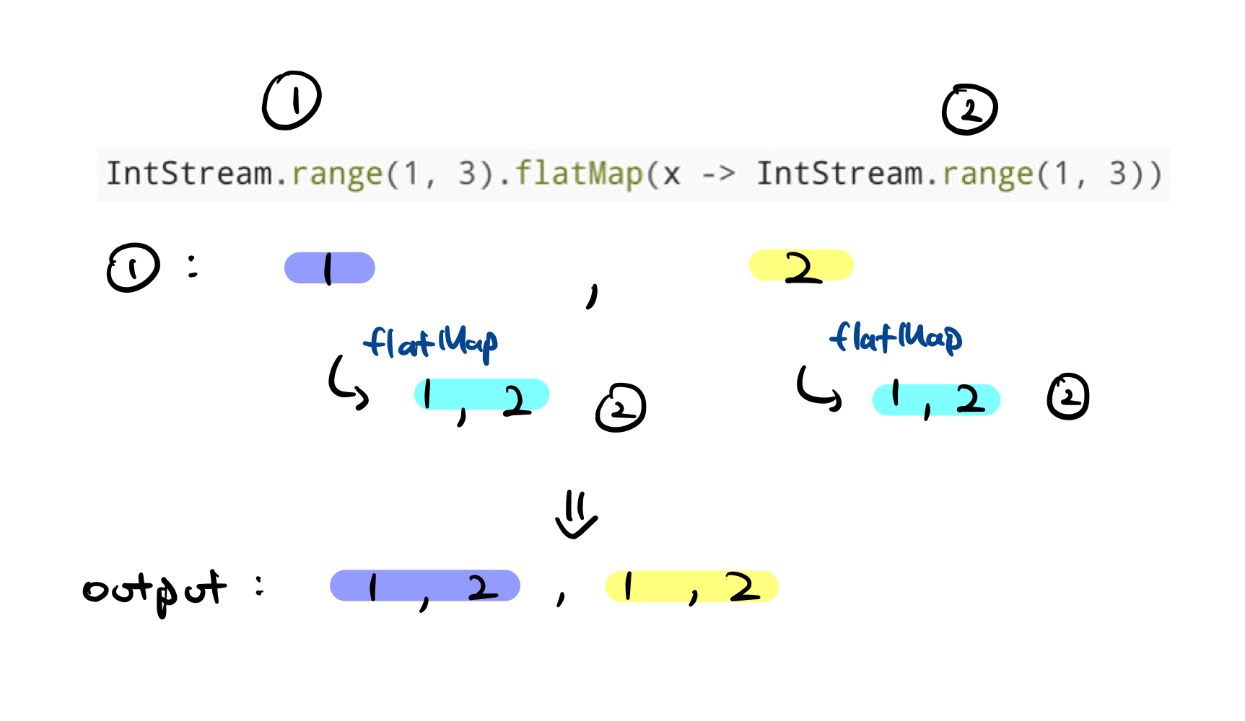
Streams - Intermediate operations

Slide 18
Streams - Terminal operations
Returns the number of elements in the stream
long count()
Reduces the elements into a single return result based on the identity element and the accumulator. (Note that there is an overloaded method for this)
T reduce(T identity, BinaryOperator<T> accumulator)

Slide 19
Streams - Terminal operations
Performs a reduction on the elements of this stream, using the provided identity value and an associative accumulation function, and returns the reduced value. This is equivalent to:
T result = identity;
for (T element : this stream)
result = accumulator.apply(result, element)
return result;

Slide 20
Streams - Terminal operations
T result = identity;
for (T element : this stream)
result = result * element + element;
return result;
T reduce(T identity, BinaryOperator<T> accumulator)
Note that it is done from left to right
IntStream.range(1, 4).reduce(1, (x, y) -> x * y + y);
(1, 2, 3).reduce(1, (x, y) -> x * y + y);
(2, 3).reduce(1, (1, 1) -> 1 * 1 + 1 // = 2 );
(2, 3).reduce(2, (x, y) -> x * y + y);
(3).reduce(2, (2, 2) -> 2 * 2 + 2 // = 6 );
(3).reduce(6, (x, y) -> x * y + y);
.reduce(6, (6, 3) -> 6 * 3 + 3);
21;

Slide 21
Lab 6
Idea Behind this Week’s Stream Exercises:
Understand the API of IntStream and Stream
Apply what we have learnt with regards to Stream operations
Rules:
No Recursion
No For Loops, No While Loops
What you are allowed:
Helper Classes, If Necessary
Helper Methods

Slide 22
Attendance

Slide 23
Start coding!

